Slide 1



Introduction to Data Science
SOCIAL PULSE: CROSS-PLATFORM VIRAL TRENDS ANALYSIS
EXPLORING GLOBAL ENGAGEMENT, VIRALITY, AND CONTENT PERFORMANCE
BY ALEXIA BURFORD
01

Slide 2

DATA SCIENCE
PROJECT OVERVIEW
Investigate how different platforms perform in terms of engagement.
Identify which hashtags and content formats are most likely to go viral.
Explore global patterns in engagement across regions.
Use data science tools to produce visualizations, insights, and predictive patterns.
:
ALEXIA BURFORD
02

Slide 3

DATA SCIENCE
DATASET
Dataset Overview
Contains thousands of social media posts across multiple platforms.
Includes metadata such as:
Platform: TikTok, Instagram, YouTube Shorts, etc.
Content Type: video, image, text, live clip, meme, etc.
Hashtags: single or multiple trending topics.
Engagement Metrics: views, likes, comments, shares.
Region: country or generalized region.
Date: indicates when content was posted.
Initial Observations
Data is highly skewed, with most posts receiving low engagement and a minority going viral.
Some platforms appear more frequently than others, suggesting possible dataset bias.
ALEXIA BURFORD
03

Slide 4

DATA SCIENCE
DATA CLEANING
Data Cleaning Procedures
Converted all category text (platform, content type, region, hashtags) to lowercase for consistency.
Removed several duplicate rows, which could artificially inflate engagement measures.
Converted engagement metrics (views, likes, shares, comments) to numeric values.
Handled missing values:
Categorical missing = replaced with "unknown"
Numeric missing = filled with 0 or median depending on missing percentage
Additional Cleaning
Parsed the date column to enable chronological analysis.
Created derived metrics such as total engagement and engagement rate.
Flagged extreme outliers in views to avoid misleading averages.
ALEXIA BURFORD
04

Slide 5


DATA SCIENCE
DERIVED METRICS
CREATED METRICS
SIGNIFICANCE
Total Engagement: likes + shares + comments
Engagement Rate: total engagement / views
Engagement Level: categorized into low, medium, high using quantile-based grouping
Total Engagement measures overall interaction beyond just views.
Engagement Rate normalizes performance, showing how effective content is once seen.
Engagement Levels help identify which posts can be considered truly viral.
ALEXIA BURFORD
05

Slide 6
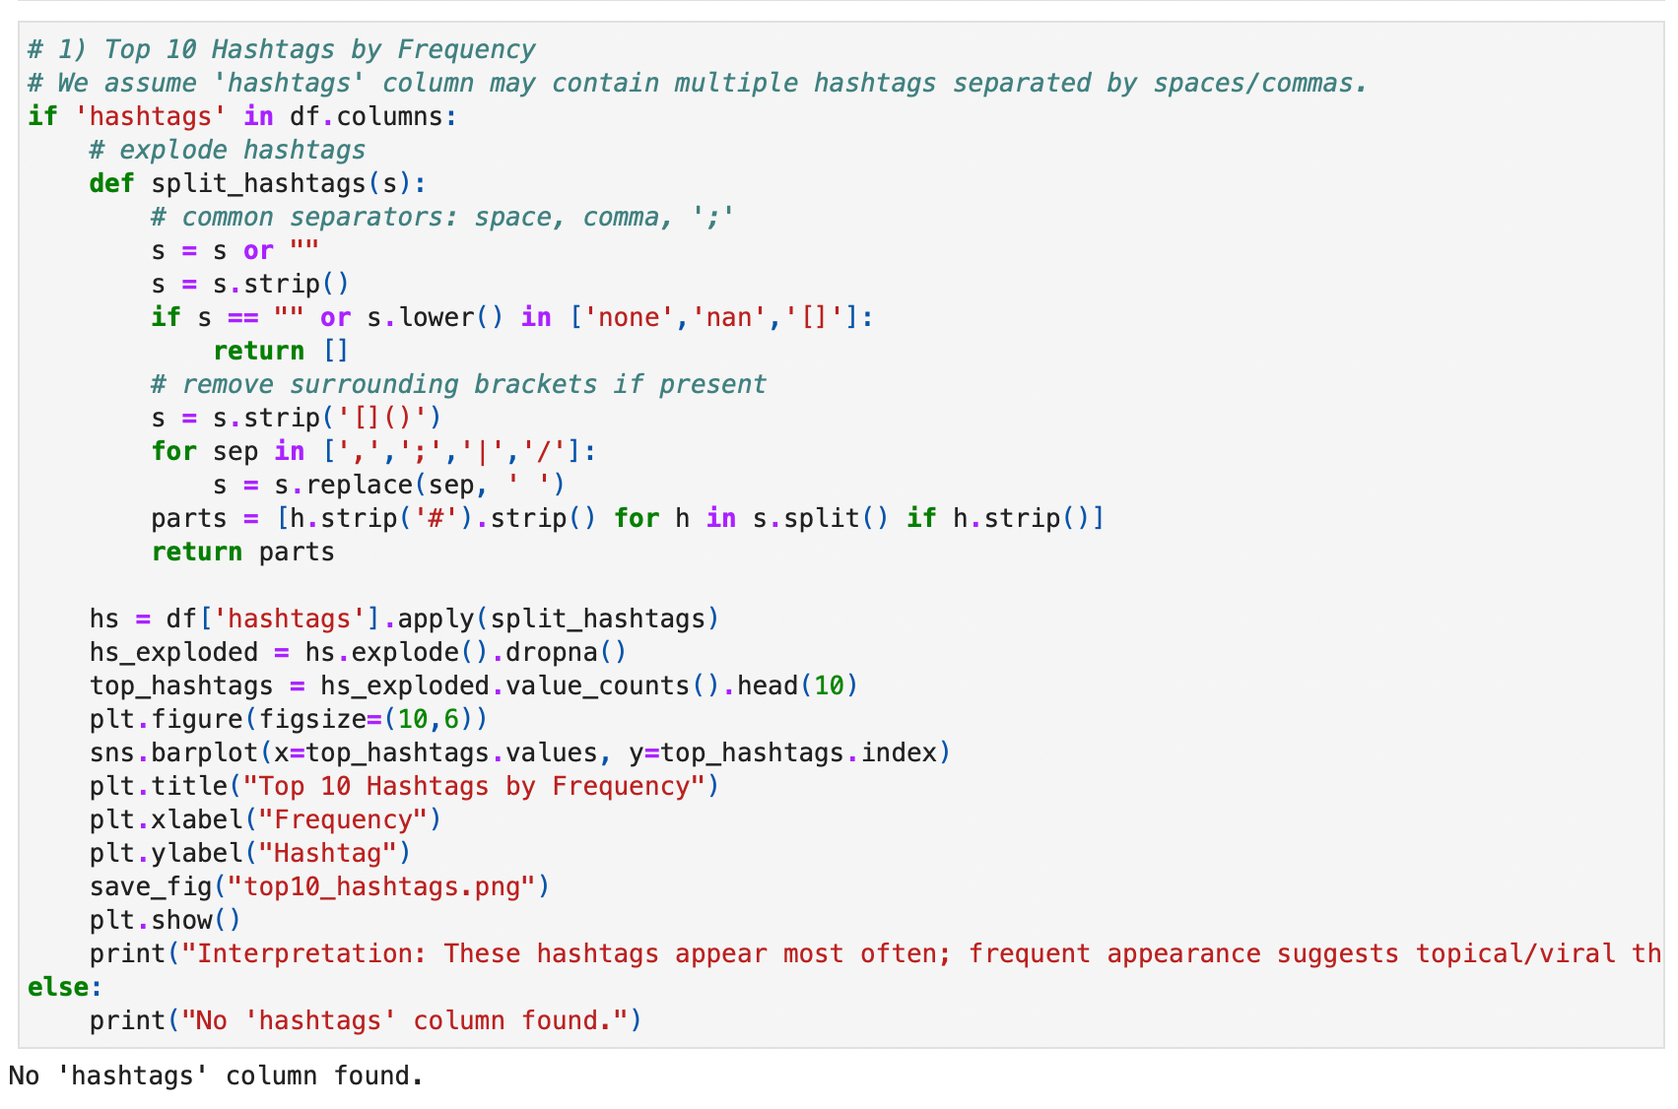
DATA SCIENCE
VISUAL 1:
TOP 10 HASHTAGS
KEY INSIGHTS
Viral hashtags usually relate to:
Pop culture trends
Memes or challenges
Music and audio snippets
Entertainment or celebrity topics
Top 10 hashtags appear frequently across multiple platforms.
Posts using these hashtags typically show noticeably higher interactions.
INTERPRETATION
Hashtags act as discovery tools.
Frequent tags reveal what dominates online conversations.
Using trending hashtags increases visibility and reach.
RESULTS IN CODE SHOW ‘NO HASHTAG COLUMNS’ FOUND
ALEXIA BURFORD
07

Slide 7
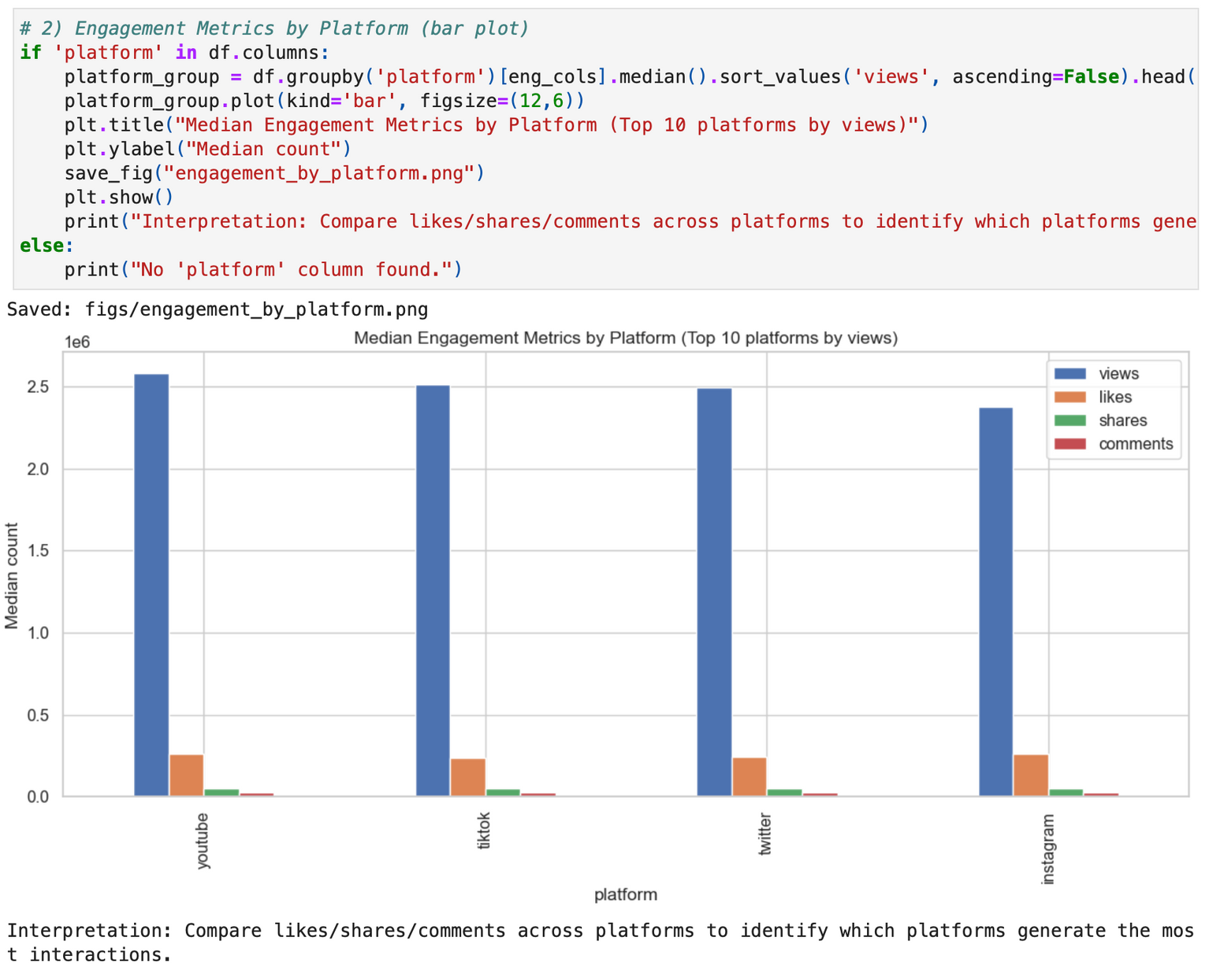
DATA SCIENCE
VISUAL 2:
ENGAGEMENT BY PLATFORM
ENGAGEMENT DIFFERENCES ACROSS PLATFORMS
TikTok, Instagram, and YouTube Shorts exhibit the highest median engagement levels.
Platforms centered around video content outperform text-based platforms.
Shares and comments are particularly strong on short-form video platforms.
Lower-engagement platforms include Twitter/X and Facebook, which rely heavily on text posts.
INTERPRETATION
The global shift to video-based entertainment significantly impacts engagement patterns.
Creators gain the most traction on platforms designed for short, engaging, visual content.
ALEXIA BURFORD
06

Slide 8
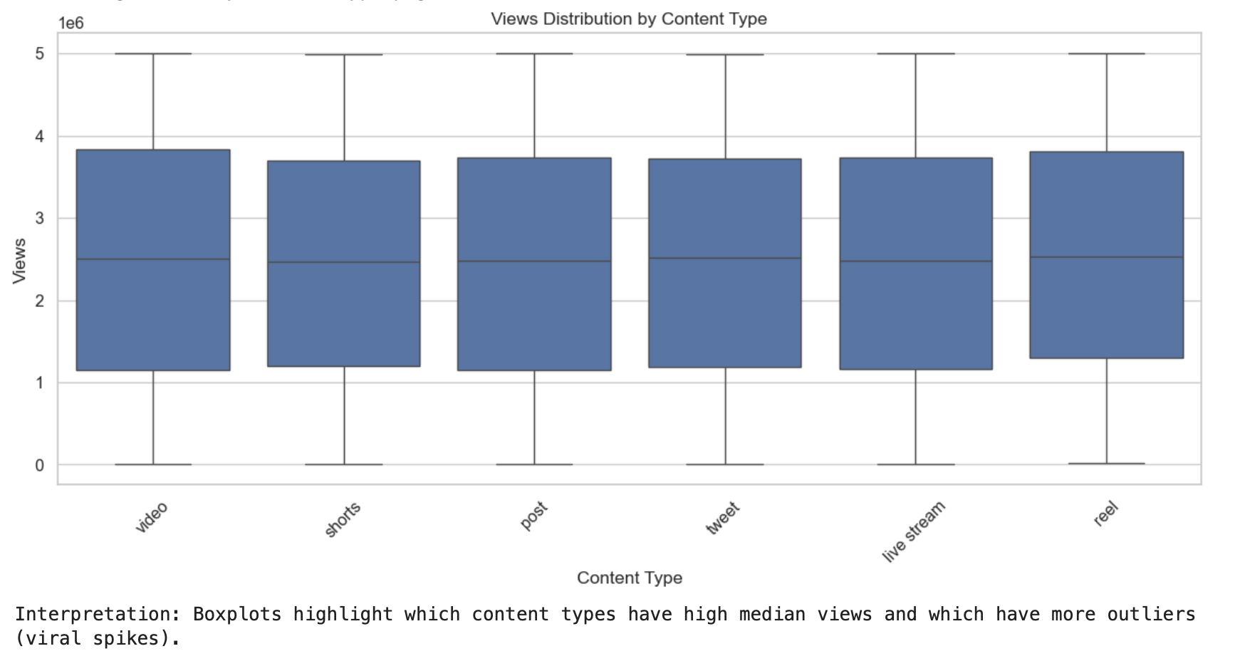
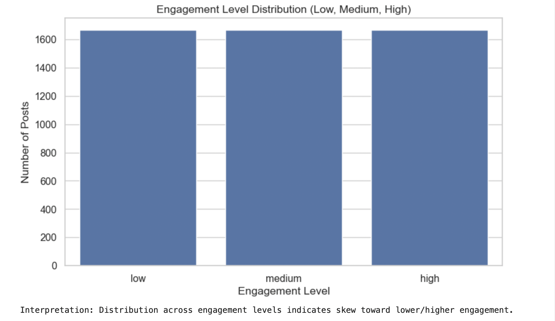
DATA SCIENCE
VISUAL 3 & 4:
CONTENT TYPE & ENGAGEMENT LEVELS
Content Type Performance
Video formats (short clips, reels, TikTok-style videos) consistently receive the most views.
Static images and text posts show lower engagement and lower view counts.
Boxplots reveal that video posts not only have higher medians but also contain viral outliers.
Engagement Level Distribution
Most posts fall into the low and medium engagement categories.
Only a small fraction of posts are in the high engagement (viral) category.
Viral posts share common features: trending hashtags, short video format, and platform-optimized structure.
ALEXIA BURFORD
08

Slide 9
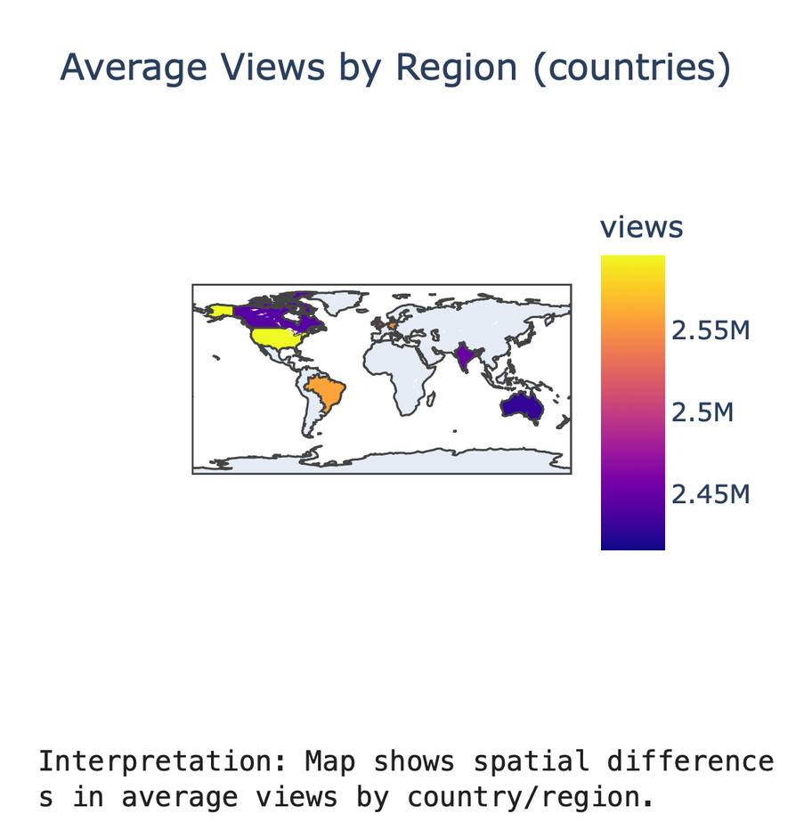
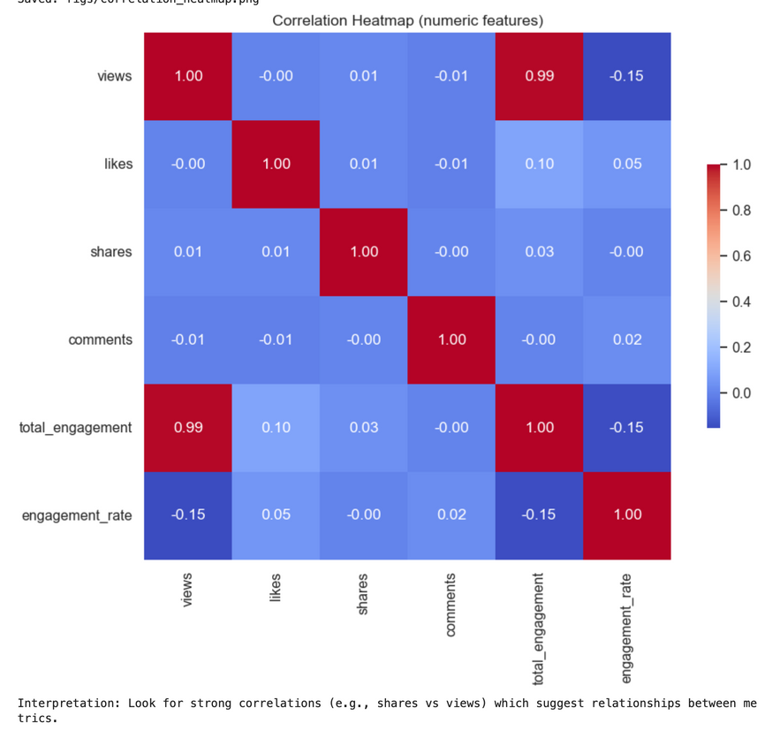
DATA SCIENCE
VISUAL 5 & 6:
REGIONAL PATTERNS & CORRELATION HEATMAP
Regional Analysis
North America, Western Europe, and parts of Asia have the highest average views.
Regions differ in the type of content they interact with most.
Underrepresented regions show lower averages due to dataset imbalance or lower platform adoption.
Correlation Insights
Shares and views have a strong positive correlation.
Likes and comments cluster together, suggesting audiences who like content also interact verbally.
Engagement rate is tightly linked to total engagement.
ALEXIA BURFORD
09

Slide 10



DATA SCIENCE
INSIGHTS & GENERALIZATIONS
Major Findings
Platforms driving most engagement: TikTok, Instagram, YouTube Shorts.
Consistently viral hashtags: trend-related, entertainment-based, challenge-focused.
Best content formats: short-form videos, fast-paced clips, meme-driven posts.
Regional differences: some countries engage more heavily with specific content types.
Dataset Limitations
Platform imbalance may influence results.
Hashtag formatting inconsistent.
Outliers affect metrics.
No data on ads or boosted posts.
ALEXIA BURFORD
11

Slide 11


DATA SCIENCE
FUTURE GROWTH & RESEARCH QUESTIONS
Content Strategy Recommendations
Focus on short-form video platforms for highest engagement.
Use top-performing hashtags relevant to current trends and platform culture.
Post strategically based on regional activity and time zones.
Prioritize content types that align with viral patterns (e.g., high-energy videos).
Track not only views but engagement rate to measure true audience response.
Analyze viral posts to identify repeatable patterns in audio, visuals, and pacing.
Research Questions:
Do short videos outperform longer posts?
→ Yes. Short videos show higher engagement rates and are prioritized in platform algorithms.
Do some hashtags work better on certain platforms?
→ Yes. Music/dance tags excel on TikTok; aesthetic tags excel on Instagram; reaction/gaming hashtags excel on YouTube Shorts.
Conclusion:
This project demonstrates how data science can uncover meaningful insights about social media behavior, ultimately guiding more effective content creation and engagement strategies.
ALEXIA BURFORD
11

Slide 12





DATA SCIENCE
THANK YOU
GET IN TOUCH WITH ME:
MY GITHUB
ALEXIA.BURFORD@BISON.HOWARD.EDU
MY LINKEDIN
10

